Slide 1
Strategies to Overcome market volatility in Islamic fund management
Hakan Ozyon
Senior Portfolio manager (Global Ethical fund)

Slide 2
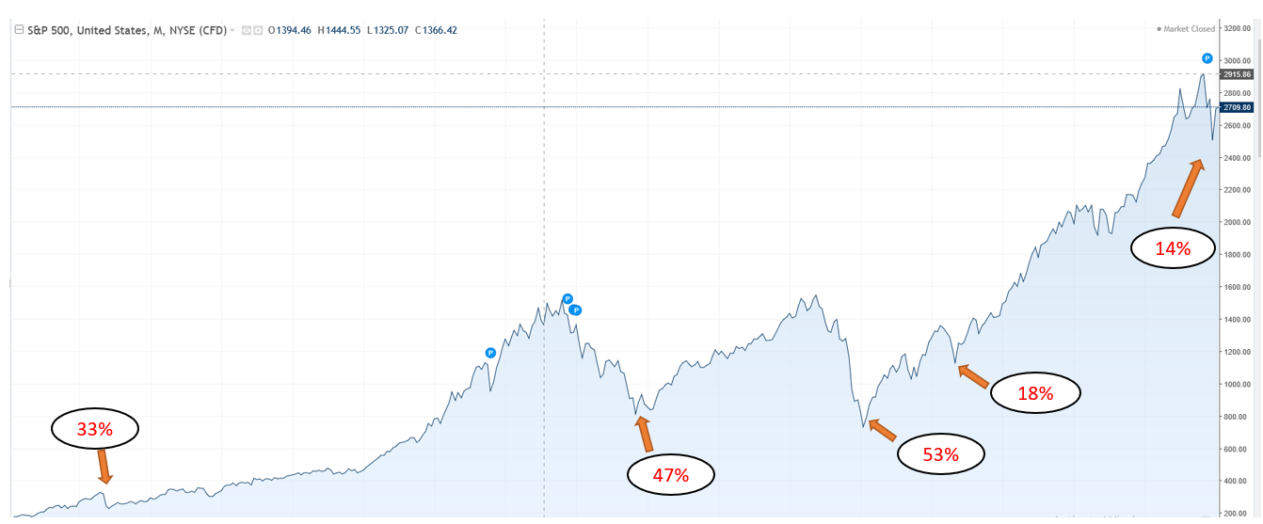
Market volatility (30 years)

Slide 3
Islamic portfolio construction
Main additional requirements:
Activity screening process
Financial screening process
Generally less diversification
Compliant fixed income solutions

Slide 4
Islamic portfolio construction
Main exclusions:
Hedging
Short positions
Quality bonds & fixed income solutions
Derivatives

Slide 5
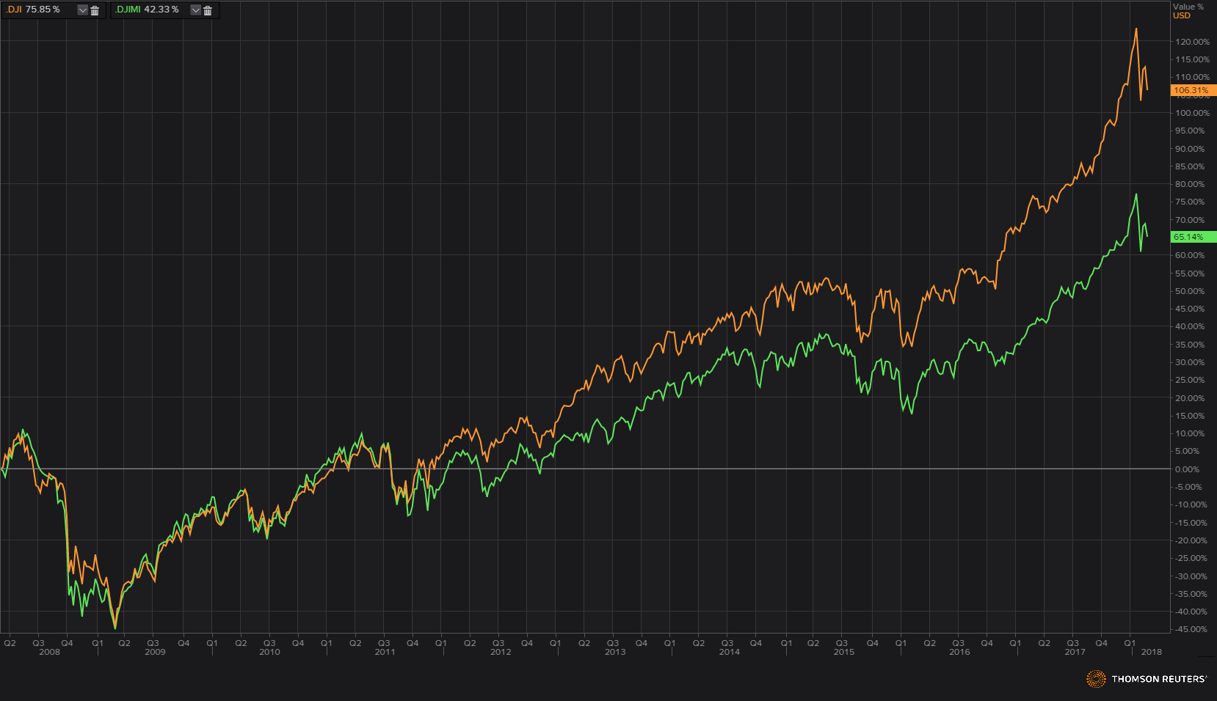
Islamic vs Conventional

Slide 6
Solutions to combat volatility
Solution 1
Understand market volatility is unavoidable, but manageable

Slide 7
Solutions to combat volatility
Solution 2
Always remain diversified

Slide 8
Solutions to combat volatility
Solution 3
Increase exposure to lower volatile assets and securities
E.g. Beta, Standard deviation

Slide 9
Solutions to combat volatility
Solution 4
Always stick to plan, never panic

Slide 10
Solutions to combat volatility
Solution 5
Dollar cost averaging

Slide 11
Solutions to combat volatility
Solution 6
Active portfolio management

Slide 12
Solutions to combat volatility
Solution 7
Tactical asset allocation

Slide 13
Solutions to combat volatility
Solution 8
Robust and comprehensive screening process

Slide 14
Solutions to combat volatility
Solution 9
High dividend and income distributions

Slide 15
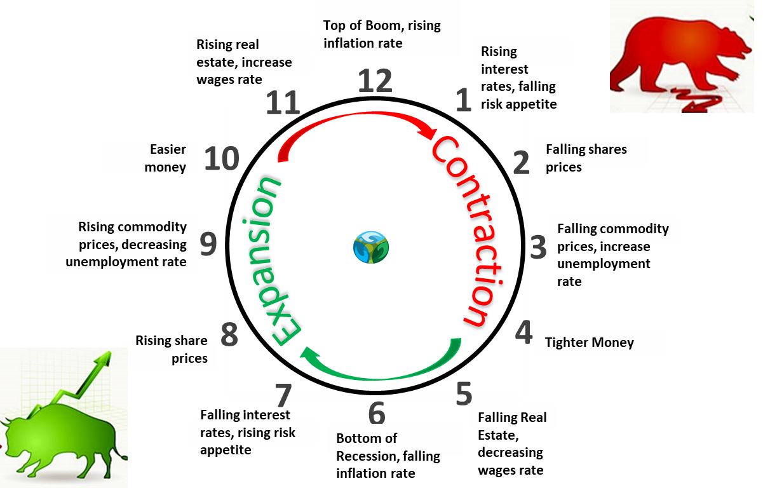
Cycles

Slide 16
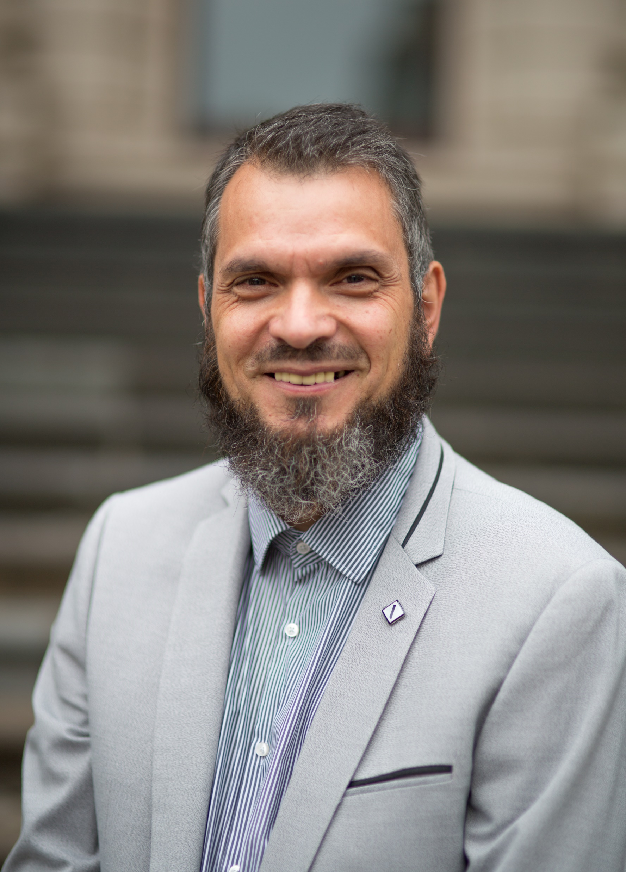
Thank you

